Slide 1
Convolutional Random Walk Networks for Semantic Image Segmentation
N S M S SACHIN:UG3-CSE:S20160010056

Slide 2
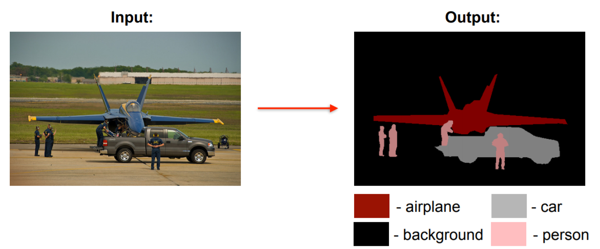
Semantic Segmentation
Given an image, we want to identify what class each pixel in the image belongs to.

Slide 3
Issues with standard CNNs:
Standard CNNs do not predict structured outputs.
Standard CNNs do not preserve local spatial information.

Slide 4
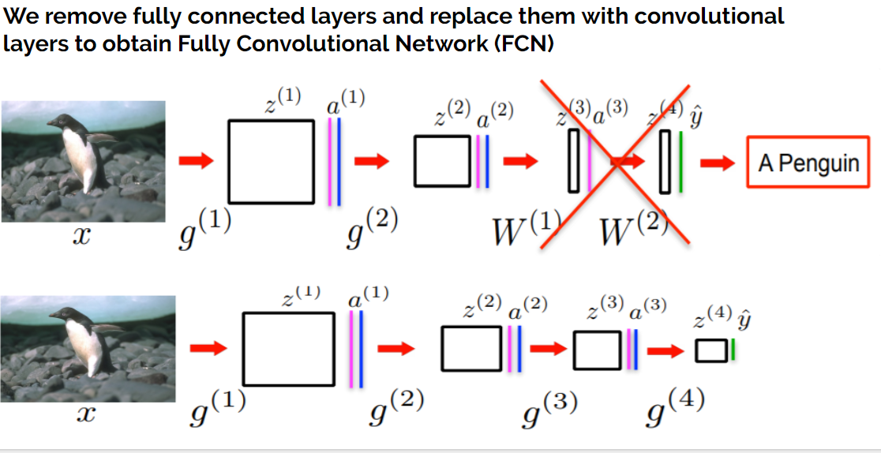

Slide 5
Issues with Fully convolutional networks (FCN)
FCNs produce 8-32 times lower resolution output than the original image.
Predictions are blurry and lack fine boundary details.
No explicit mechanism to preserve structure in an image.
FCN tries to predict as many pixels correctly as possible without necessarily preserving the structure!

Slide 6
Convolutional Random Walk Networks
Convolutional Random Walk Network (RWN) addresses the issues of poor boundary localization and spatially fragmented predictions with very little increase in model complexity.
It jointly optimizes the objectives of pixelwise affinity and semantic segmentation
RWN is implemented using standard convolution and matrix multiplication.
RWN does not need post-processing, it is implemented using standard layers and loss functions, and it also has a compact model.
RWN seamlessly integrates both affinity and segmentation branches, and can be jointly trained endto-end via standard back-propagation with minimal modifications to the existing FCN framework.

Slide 7
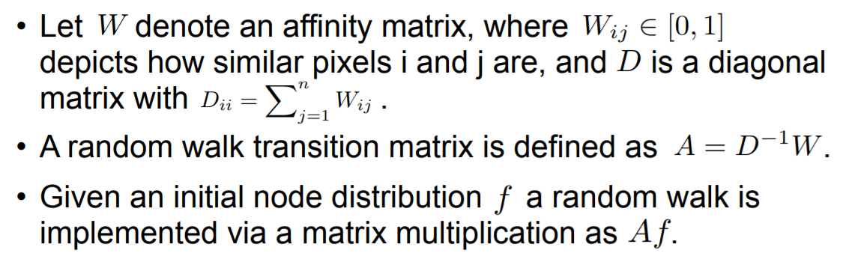
Convolutional Random Walk Networks
Simulating random walk forces similar nodes to cluster together

Slide 8
Convolutional Random Walk Networks
A network consisting of two branches.
The first branch predicts initial semantic segmentation potentials .
The second branch predicts a random walk transition matrix .
The outputs from both branches are combined via a random walk layer as .
RWN can be jointly trained end-to-end using the standard back propagation framework.

Slide 9
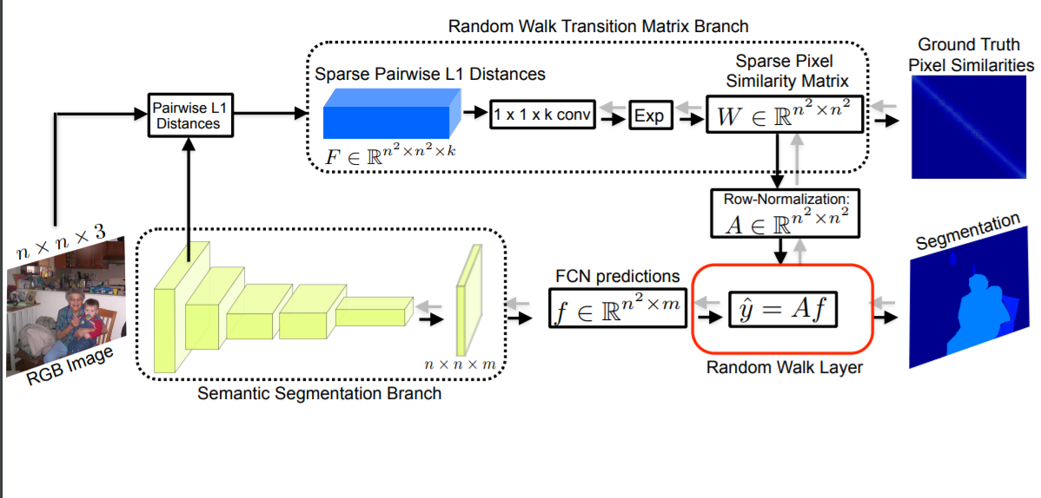
Convolutional Random Walk Networks

Slide 10
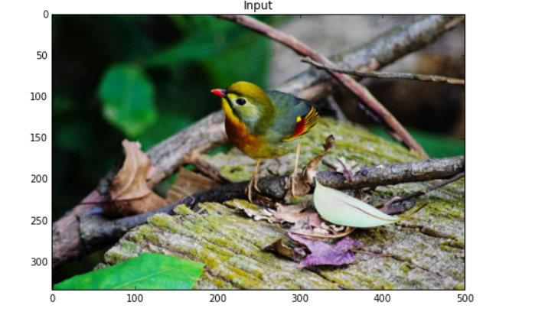
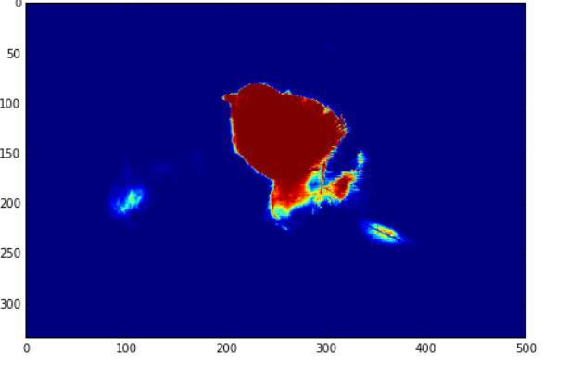
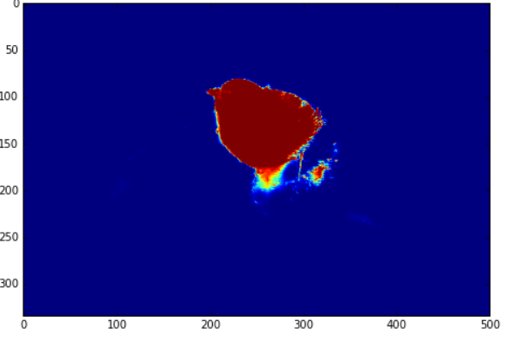
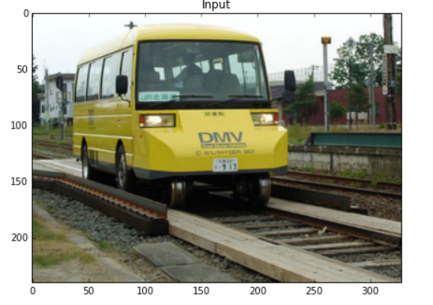
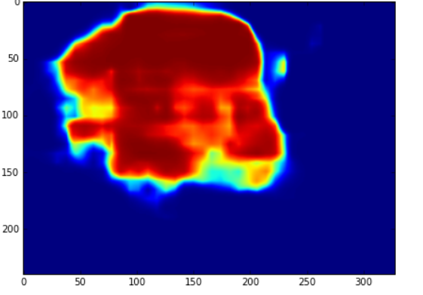
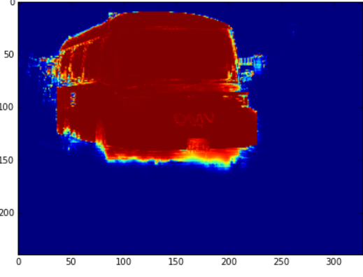
Convolutional Random Walk Networks
Input image
f
y^ = Af

Slide 11
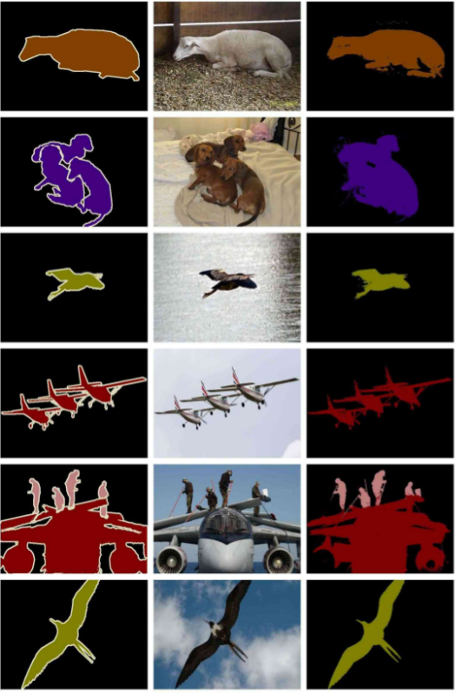
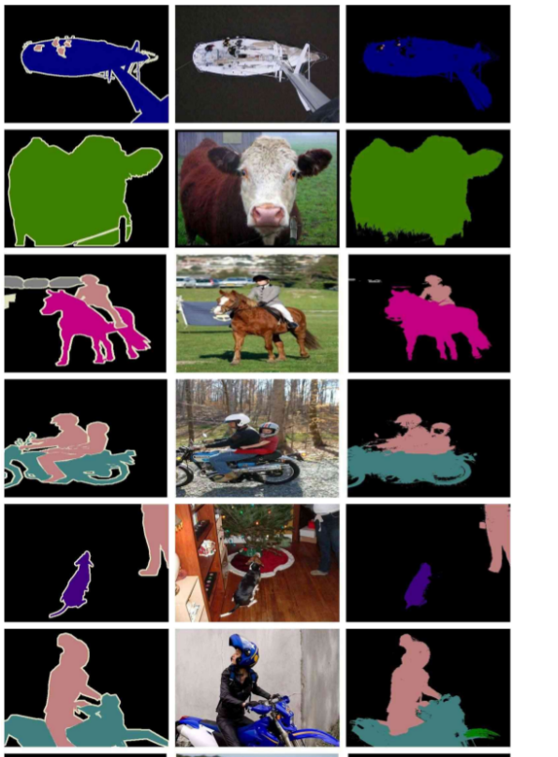
Convolutional Random Walk Networks
This network is trained on PASCAL-VOC -2012 dataset over 6000 training images and achieved mean IOU of 60.80 , pixel accuracy 74.50.
These are some of the results:

Slide 12
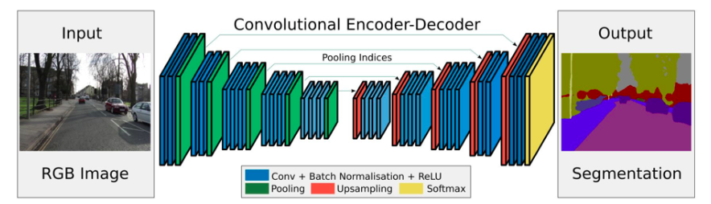
SEG-NET
SegNet is composed of a symmetry network: the encoder and the decoder .
Uses a novel technique to upsample encoder output which involves storing the max-pooling indices used in pooling layer. This gives reasonably good performance and is space efficient
This network achieved mean IOU of 62.25 and pixel accuracy of 78.81.

